Slide 1
Software Design and Architecture
Modularity

Slide 2
Maintainability
Maintainability is about the ease of adding, changing, or removing features, as well as applying internal changes such as maintenance patches, framework upgrades, third party upgrades, and so on.

Slide 3
Maintainability as a Modularity Driver
Consider a change is to add an expiration date to items contained in a customer’s wish list (items in a list to maybe purchase at a later time) on three architectures.
Monolithic layered architectures
Service-based architectures
Microservices architectures
Observe impact of modularity on maintainability.

Slide 4
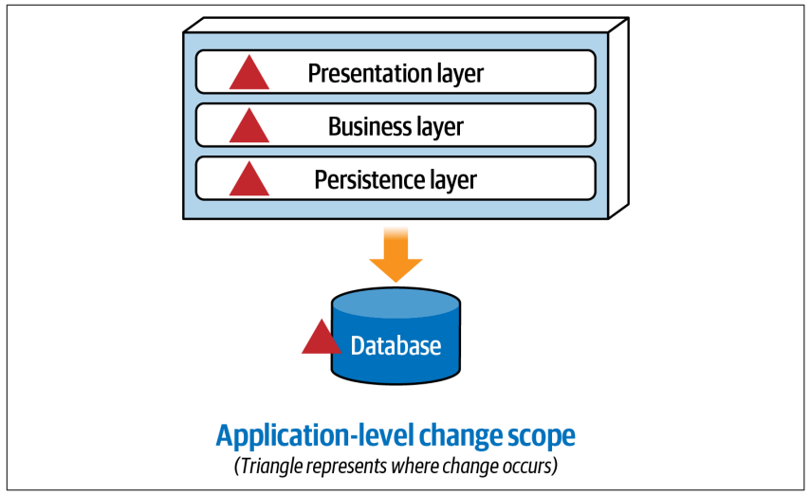
Monolithic layered architectures

Slide 5
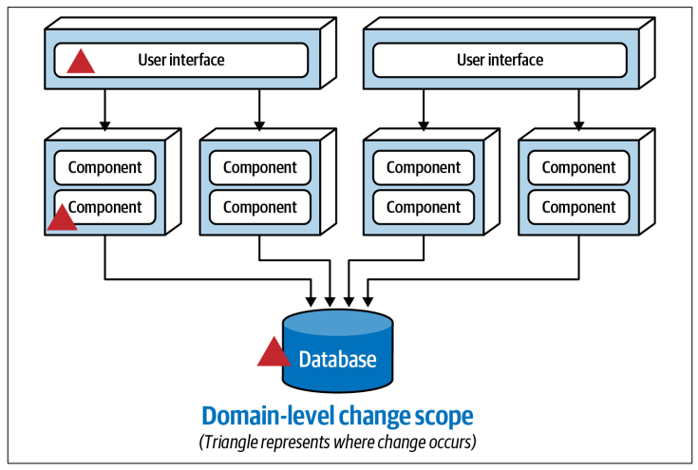
Service-based architectures

Slide 6
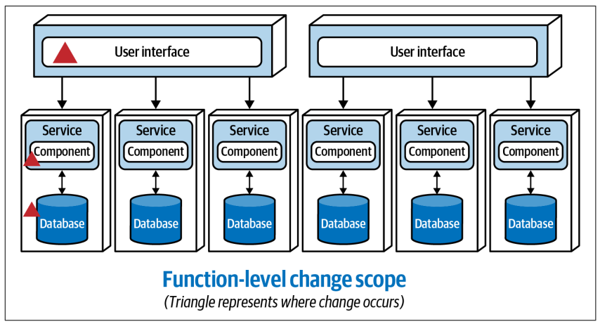
Microservices architectures

Slide 7
Module and Modularity
Module: Each of a set of standardized parts or independent units that can be used to construct a more complex structure
Modularity: The degree to which a module may be separated and recombined, often with the benefit of flexibility and variety in use.

Slide 8
Measuring Modularity
Three key concepts to help architects understand modularity:
Cohesion: It is a measure of how related the parts of a module are to one another
Coupling: It is a measure of how related the modules are to one another
Connascence: Two components are connascent if a change in one would require the other to be modified in order to maintain the overall correctness of the system

Slide 9
Cohesion
Attempting to divide a cohesive module would only result in increased coupling and decreased readability.
A range of cohesion measures, listed from best to worst:
Functional cohesion
Sequential cohesion
Communicational cohesion
Procedural cohesion
Temporal cohesion
Logical cohesion
Coincidental cohesion

Slide 10
Cohesion
Functional cohesion
Parts of the module are related to the other, and the module contains everything essential to function.

Slide 11
Cohesion
Sequential cohesion (flow is of the data )
Parts of a module are grouped because the output from one part is the input to another.

Slide 12
Cohesion
Communicational cohesion
Parts of a module are grouped together because they use the same set of inputs and outputs.

Slide 13
Cohesion
Procedural cohesion (flow is of functionality)
Parts of a module are grouped because they always follow a certain sequence of execution.

Slide 14
Cohesion
Temporal cohesion
Parts of a module are grouped together based on when they are processed.
For example, many systems have a list of seemingly unrelated things that must be initialized at system startup; these different tasks are temporally cohesive.

Slide 15
Cohesion
Logical cohesion
Parts of a module are grouped together because they are related in some way logically.
For example, a module that contains a set of functions that handles I/O for the application. While they are related logically, the nature of the various functions would be quite different.

Slide 16
Cohesion
Coincidental cohesion
Elements in a module are not related other than being in the same source file; this represents the most negative form of cohesion.

Slide 17
Cohesion
An architect defines the degree of cohesiveness of a particular module.
Consider this module definition:
Customer Maintenance
• add customer
• update customer
• get customer
• notify customer
• get customer orders
• cancel customer orders
Should the last two entries reside in this module?

Slide 18
Cohesion
Should the developer create two separate modules, such as:
Customer Maintenance
• add customer
• update customer
• get customer
• notify customer
Order Maintenance
• get customer orders
• cancel customer orders
Which is the correct structure? As always, it depends:

Slide 19
Cohesion
Trade-off analysis: the job of a software architect.
Are those the only two operations for Order Maintenance? If so, it may make sense to collapse those operations back into Customer Maintenance.
Is Customer Maintenance expected to grow much larger, encouraging developers to look for opportunities to extract behavior?
Does Order Maintenance require so much knowledge of Customer information that separating the two modules would require a high degree of coupling to make it functional?

Slide 20
Coupling
Afferent and efferent coupling
Afferent coupling measures the number of incoming connections to a code artifact (component, class, function, and so on).
Efferent coupling measures the outgoing connections to other code artifacts.

Slide 21
Derived Coupling metrics: Abstractness
The abstractness (A) is the ratio of abstract classes and interfaces to the total number of classes and interfaces in a package.
A = Na / Nc
Na: The number of abstract classes and interfaces in this component.
Nc: The number of all classes and interfaces in this component.
This metric has the range [0, 1]. A=0 indicates that this package has no abstract classes or interfaces. A=1 indicates that this package only contains abstract classes or interfaces.

Slide 22
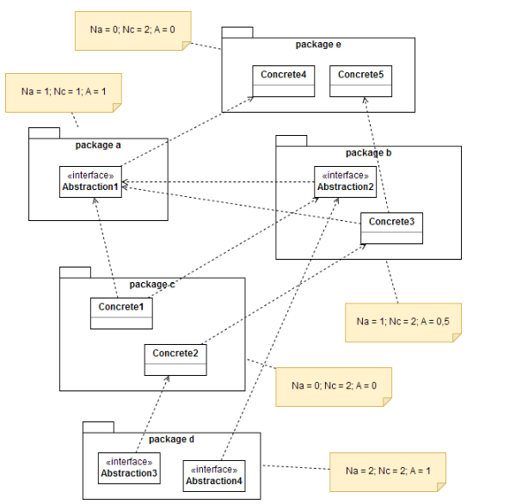
Derived Coupling metrics: Abstractness

Slide 23
Derived Coupling metrics: Instability
The instability (I) is the ratio of efferent coupling to the sum of both efferent and afferent coupling.
I = Ce / (Ca + Ce)
Ce: efferent couplings (the number of outgoing dependencies)
Ca: afferent couplings (the number of incoming dependencies)
A module is the more unstable the more dependencies to other packages is has.
This metric has the range [0, 1]. I=0 indicates a maximally stable component.

Slide 24
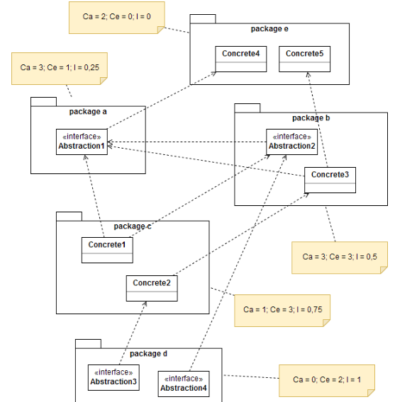
Derived Coupling metrics: Instability

Slide 25
Derived Coupling metrics: Distance from the Main Sequence (D)
D=|A+I−1|
The main sequence defines the ideal relationship between abstractness and instability.
A module is totally abstract or totally instable at the best.

Slide 26
Derived Coupling metrics: Distance from the Main Sequence (D)

Slide 27
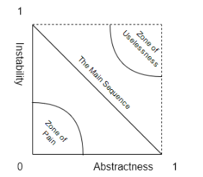
Derived Coupling metrics: Distance from the Main Sequence (D)
The module with high abstractness and high instability (with no dependents) are in the zone of uselessness.
The module with low abstractness and low instability are in the zone of pain.

Slide 28
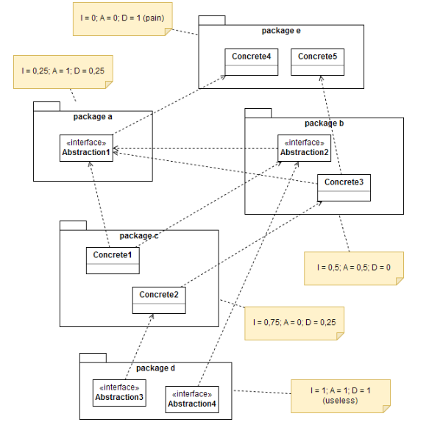
Derived Coupling metrics: Distance from the Main Sequence (D)

Slide 29
Connascence
It’s a refinement of the afferent and efferent coupling metrics and recasting them to object-oriented languages.
Two types of connascence:
Static: source-code-level coupling
Dynamic: execution-time coupling

Slide 30
Static Connascence
Connascence of Name (CoN)
Multiple components must agree on the name of an entity.
Connascence of Type (CoT)
Multiple components must agree on the type of an entity.
Connascence of Meaning (CoM) or Connascence of Convention (CoC)
Multiple components must agree on the meaning of particular values.
Connascence of Position (CoP)
Multiple entities must agree on the order of values.
Connascence of Algorithm (CoA)
Multiple components must agree on a particular algorithm.

Slide 31
Dynamic Connascence
Connascence of Execution (CoE)
The order of execution of multiple components is important.
Connascence of Timing (CoT)
The timing of the execution of multiple components is important.
Connascence of Values (CoV)
Occurs when several values relate on one another and must change together.
Connascence of Identity (CoI)
Occurs when occurs when the same object must be referenced at two or more .

Slide 32
Connascence Properties
Connascence is an analysis tool for architect and developers, and some properties of connascence help developers use it wisely.
Strength
Locality
Degree

Slide 33
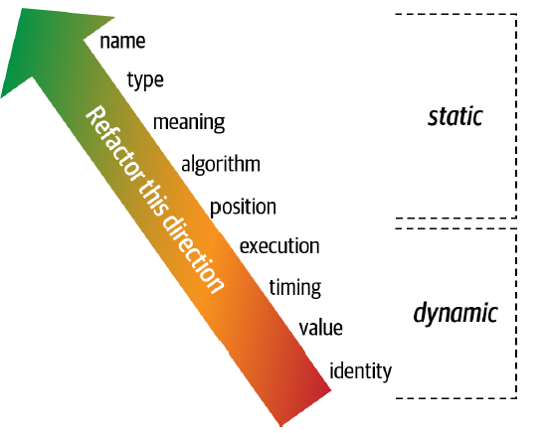
Strength
Architects determine the strength of connascence by the ease with which a developer can refactor that type of coupling.
Stronger connascences are harder to discover, or harder to refactor.

Slide 34
Locality
Describes how close the coupled components are. A high locality is better and means coupled components are in the same module.

Slide 35
Degree
Describes how many components are coupled. Components with a large number of connascent entities are a more significant issue than just a few connascent entities.

Slide 36
Three guidelines for using connascence to improve systems modularity:
Minimize overall connascence by breaking the system into encapsulated elements
Minimize any remaining connascence that crosses encapsulation boundaries
Maximize the connascence within encapsulation boundaries

Slide 37
Two great pieces of connascence advice
Rule of Degree: convert strong forms of connascence into weaker forms of connascence
Rule of Locality: as the distance between software elements increases, use weaker forms of connascence

Slide 38
Reference
Fundamentals of Software Architecture: An Engineering Approach. Mark Richards and Neal Ford (2020): O’REILLY
Chapter 3

